Slide 1
Celebrating 50 Years of Alcohol Research: NIAAA Milestones and Priorities
George F. Koob, Ph.D.
Director
National Institute on Alcohol Abuse and Alcoholism
RSA Virtual Closing Ceremony
June 24, 2020

Slide 2
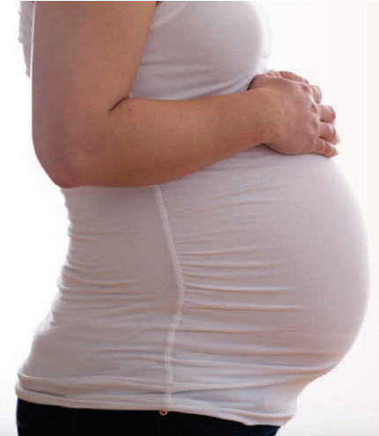
Milestones in FASD Research
1970s: Fetal Alcohol Syndrome was formally recognized by researchers
NIAAA research increased knowledge of alcohol-related birth defects and related conditions, leading to the establishment of the new, broader umbrella terminology currently in use: Fetal Alcohol Spectrum Disorders (FASD)
1988: Alcoholic Beverage Labeling Act leads to government warning label on alcoholic beverages about the risk of birth defects due to drinking during pregnancy
2018: More accurate estimates of FASD prevalence in the U.S. were provided by an NIAAA-funded study of more than 6,000 first-graders. Researchers conservatively estimated a range of 1-5 percent in community samples.

Slide 3
Milestones in Prevention
PROGRESS: Binge drinking continues to decline among middle- and high-school students
1984: The National Minimum Drinking Age Act required states to raise their minimum purchase and public possession of alcohol age to 21
2004: NIAAA established the Underage Drinking Research Initiative, which provided much of the scientific foundation for the 2007 Surgeon General’s Call to Action to Prevent and Reduce Underage Drinking
2006: Sober Truth On Preventing Underage Drinking (STOP) Act enacted by Congress called for a national effort to address underage drinking
2011: NIAAA published Alcohol Screening and Brief Intervention for Youth: A Practitioner's Guide
Source: Monitoring the Future 2019

Slide 4
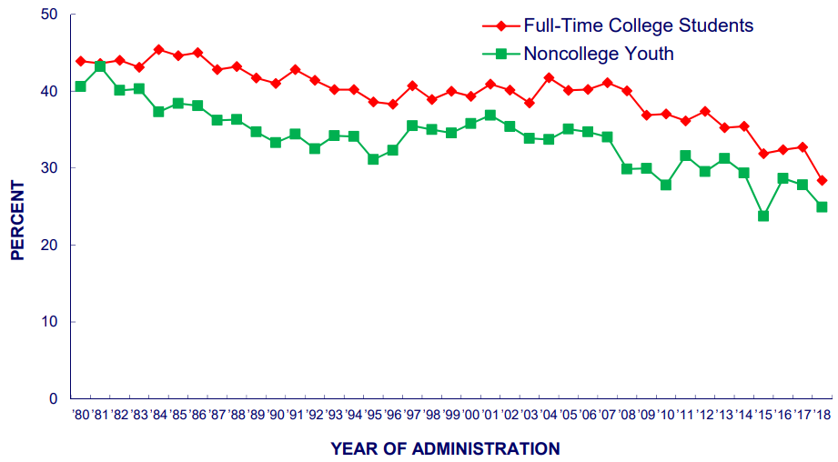
Milestones in Prevention: College Drinking
1998: NIAAA established a Task Force on College Drinking
2002: NIAAA published the Task Force report A Call to Action: Changing the Culture of Drinking at U.S. Colleges
2015: NIAAA launched the College Alcohol Intervention Matrix (CollegeAIM), a resource to help schools address harmful and underage student drinking
PROGRESS: Binge drinking among college students has declined from over 40% in 1980 to under 30% in 2018
FIVE OR MORE DRINKS IN A ROW:
Trends in 2-Week Prevalence
This is an all-time low for college students!
YEAR
Source: Monitoring the Future 2019

Slide 5
Milestones in Treatment and Medications Development for Alcohol Use Disorder
1970: When NIAAA was established, only disulfiram was FDA approved for AUD treatment
1995: FDA approval of naltrexone for AUD treatment (long-lasting injectable version approved by the FDA in 2006)
2004: FDA approval of acamprosate for treatment of AUD
1990s to present: Behavioral therapies for AUD, such as cognitive behavioral therapy, motivational interviewing, and AA/12-step facilitation, have proven effective and have paved the way for treatment of other substance use disorders
2005: NIAAA published Helping Patients Who Drink Too Much: A Clinician’s Guide to support integration of SBI in primary care
2007: Launch of NIAAA Clinical Investigations Group, a nationwide network of research sites for conducting Phase II clinical trials of promising compounds
Supported by NIAAA Human Laboratory Program (started in 2016) that screens candidate compounds for effectiveness

Slide 6
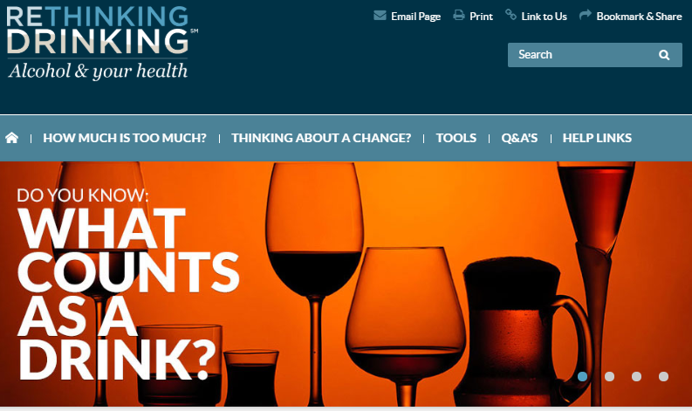
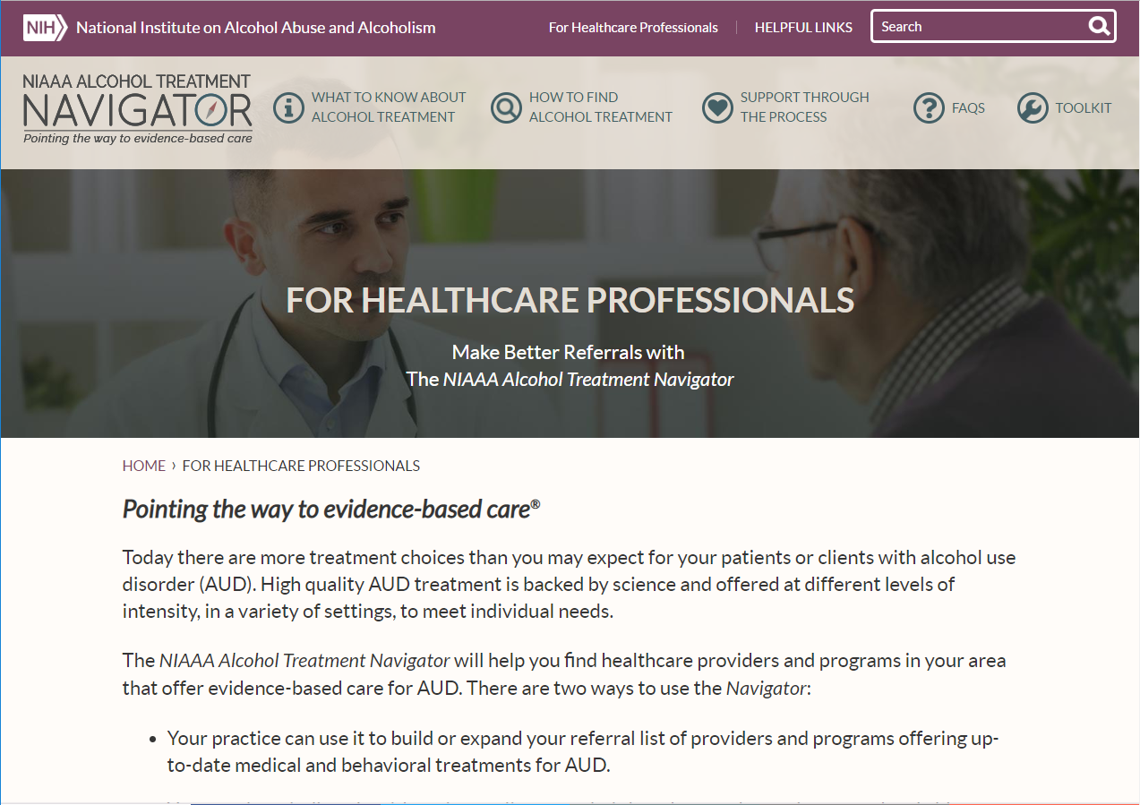
Ongoing Efforts to Close the Treatment Gap: Resources for the Public
2009: NIAAA released Rethinking Drinking, a website and print publication to help individuals assess their drinking habits and find ways to make a change.
This website regularly receives 100,000+ visits per month and the print edition has historically been NIAAA’s most-requested publication.
2017: NIAAA launched the Alcohol Treatment Navigator, an online resource to help people understand treatment options and locate nearby treatment

Slide 7
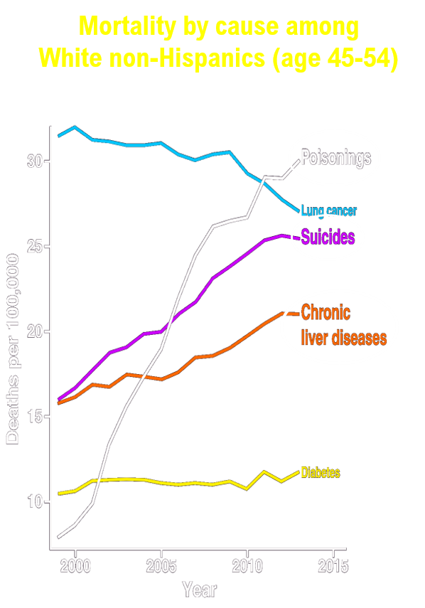
A New Report Highlights Changes in Alcohol-Related Deaths in the United States
Alcohol-related deaths doubled from 1999 to 2017
Death rates were highest among men and middle-aged and older adults (ages 45-74)
Death rates increased over time across all age groups except 16-20 and 75+
Increase in death rate over time was greater in women than men
These statistics align with other recent reports that have highlighted changing trends in drinking patterns and increased consequences of alcohol in women and the aging population
Alcohol plays a prominent role in “deaths of despair”, contributing to:
15-20% of all drug overdoses
26% of suicides
50% of liver disease deaths
Citation: White AM, Castle IP, Hingson RW, and Powell PA. 2020. ACER. 44 (1):178-187
Case and Deaton, 2015

Slide 8
Responding to Current Issues in Alcohol Research
Women and alcohol
NIAAA participation in Office of Research on Women’s Health (ORWH) RFA “Intersection of Sex and Gender Influences on Health and Disease” (RFA-OD-19-029) and several other ORHW NOSIs
Interactions between alcohol, pain, and sleep disturbances
Ongoing participation in HEAL initiative RFAs
NIAAA issued RFA “Mechanistic studies on chronic alcohol use and sleep homeostasis”
NIAAA participation in NCCIH FOA “Mechanisms Underlying the Contribution of Sleep Disturbances to Pain” (PA-19-200)
Alcohol use among aging adults
NIAAA collaboration with NIA for RFA “Impact of Alcohol on the Onset and Progression of Alzheimer’s Disease and Its Related Dementias”

Slide 9
Moving Forward
Recovery research could benefit from a common definition of recovery for increased consistency in recovery assessment
In consultation with key stakeholders, NIAAA proposed defining recovery as a process through which an individual pursues both remission from AUD and cessation from heavy drinking
Recovery may be characterized by fulfillment of basic needs, enhancements in social support and spirituality, and improvements in well-being
Next steps: Dissemination and evaluation of this definition, which is open to revision based on empirical evidence
FASD research across the world currently reflects 11 different classification systems for FASD
In October 2019, NIAAA convened a consensus meeting to initiate development of a single research classification system to harmonize international research efforts on FASD
This effort is ongoing…stay tuned!

Slide 10
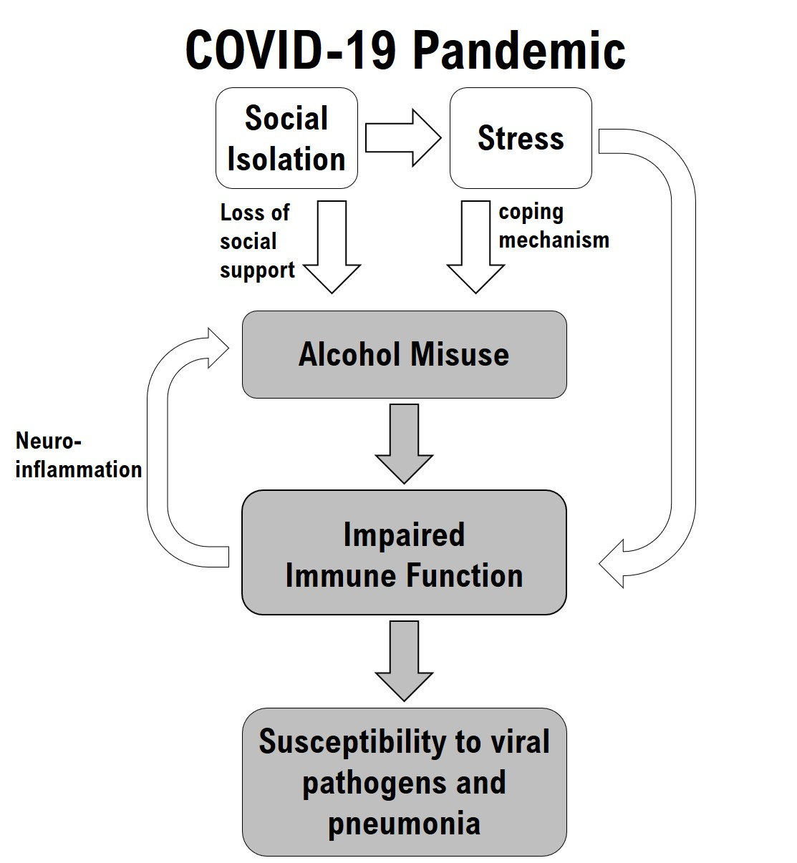
Supporting Research on Alcohol and COVID-19
Notice of Special Interest (NOSI) – Administrative and Competitive Revision Supplements on COVID-19 within NIAAA Mission: NOT-AA-20-011
Participation in other NIH COVID-19 NOSIs – see full list on NIAAA website: https://www.niaaa.nih.gov/funding-opportunities
NIAAA supports resources to facilitate research on downstream public health effects of the COVID-19 pandemic:
Alcohol Policy Information System (APIS) updated to include new information about state level alcohol-related COVID-19 policies
Commissioned reports of monthly apparent per capita alcohol sales during the pandemic

Slide 11
NIAAA Commitment to Supporting a Diverse Research Community and Research on Health Disparities
Recent instances of social injustice among African-Americans and the health disparities highlighted by the COVID-19 pandemic are a call to action for NIH and the entire scientific community
To eliminate health disparities and diversify the scientific workforce, NIAAA is committed to:
Significantly increasing diversity and fully embracing inclusion in the scientific workforce
Eliminating disparities in funding among grantees from underrepresented groups
Expanding health disparities research
Ensuring that our research and outreach benefits underserved communities
NIAAA welcomes your input on what we can do towards achieving equality in alcohol research and cultivating a research culture that is welcoming, inclusive, and fair to all

Slide 12
Supporting the Next Generation of Alcohol Researchers: Increases in NIAAA Training and Career Development Awards
Total number of positions or awards

Slide 13
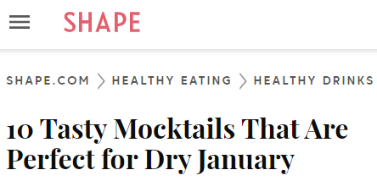
Are we experiencing a cultural shift in attitudes about alcohol use?
Observance of sober months (Dry January, Sober October, etc) is gaining popularity
Sober Curious movement is also receiving a lot of attention
These trends encourage a focus on wellness
U.S. Dietary Guidelines for Alcohol Consumption
For adults 21 and older:
No more than 2 drinks per day for men
No more than 1 drink per day for women
For individuals under age 21:
No alcohol

Slide 14
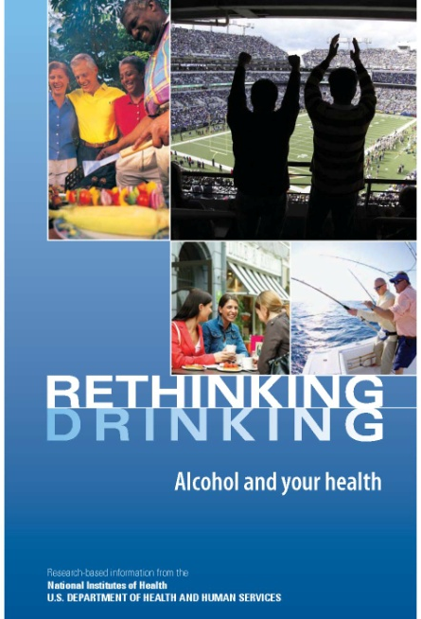
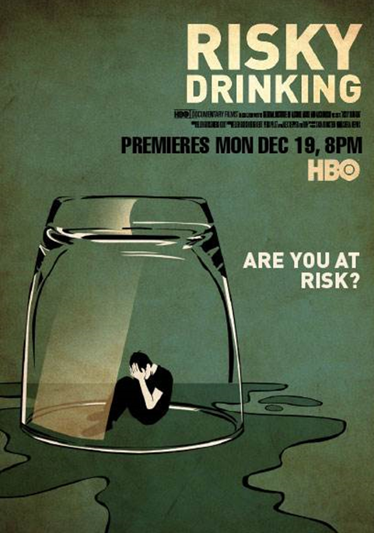
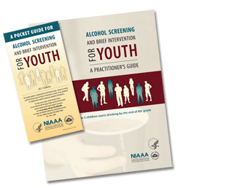
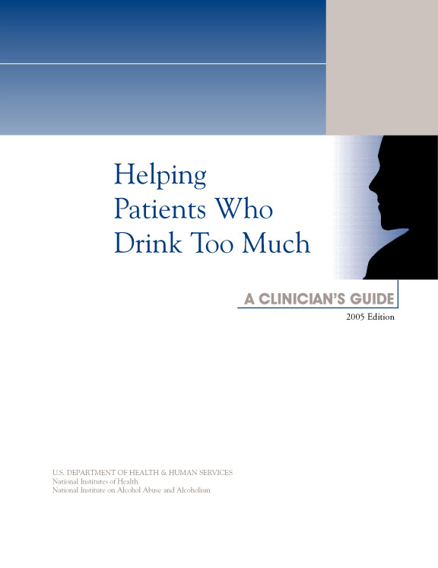
NIAAA
Your source for credible, evidence-based information about alcohol and health.
www.niaaa.nih.gov
Special thanks to Rachel Anderson
Notes:
End slide?

