Slide 1
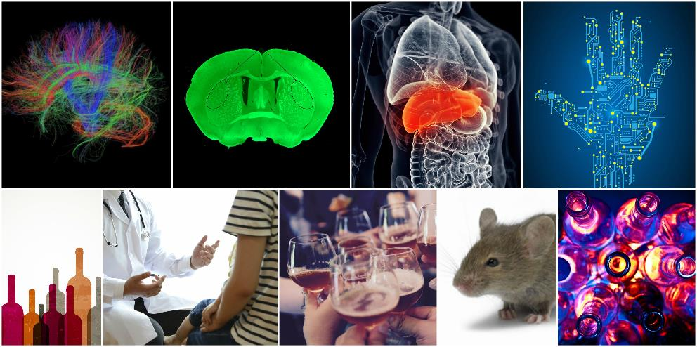
NIAAA Update
George F. Koob, Ph.D.
Director, National Institute on Alcohol Abuse and Alcoholism
National Institutes of Health
Research Society on Alcoholism
Annual Meeting
June 23, 2019
Obi-Wan appears when answering a question submitted by the RSA community.

Slide 2
In Memoriam
Ting-Kai Li, MD, a renowned scientist who served as NIAAA's director from 2002 to 2008, passed away on November 18, 2018.
As NIAAA Director, Dr. Li provided visionary leadership, blending administrative expertise with a comprehensive understanding of alcohol’s impact at the metabolic, neurobiological, clinical, epidemiological, and societal levels.
His legacy will live on in his work and contributions to the alcohol field.
Join us tomorrow morning for a special session:
Ting-Kai Li: A Tribute to the Father of Studies of Alcoholism

Slide 3
NIAAA Budget
The FY 2019 budget included $39.3 billion for NIH
NIAAA received $525.6 million ($16 million increase from FY 2018 enacted level)
The FY 2020 budget is under development.
Several factors influence grant project award and start dates, including the budget process and availability of funds. Start dates may be delayed if there are unresolved issues related to human/animal subject protections or data sharing plans in the application.

Slide 4
Good News: NIAAA Success Rates 2014- 2018
NIAAA
NIH

Slide 5
Reminder: NIAAA R01 and R21 Success Rates
Apply for R21 if you are planning to generate data that can lead
to the submission of an R01—otherwise go for the R01!
Notes:
Data from NIAAA budget office.

Slide 6
NIAAA Supports F32 Individual Awards
Applicants should submit as soon as they become eligible – during the 1st or 2nd year of postdoctoral training (or even before starting the postdoctoral position)
Application should be focused on an integrated program of training and research
Inclusion of preliminary data is not needed, and is discouraged to facilitate early submission of the applications
Publications from postdoctoral studies are not required
Notes:
052814 Koob NIAAA

Slide 7
NIH Pathway to Independence Award (K99/R00) Eligibility
Candidates are strongly encouraged to confirm their eligibility with NIAAA before preparing an application
No more than 4 years of aggregate postdoctoral research experience on the submission due date (PA-19-129; PA-19-130)
No more than 5 years of aggregate postdoctoral research experience on the submission due date (BRAIN Diversity Initiative PAR-18-813; PAR-18-814)
Postdoctoral research experience is pro-rated based on
Parental, medical, or family leave
Full-time residency training
Part-time postdoctoral training or fellowship
Point of Contact: Lynn Morin (lynn.morin@nih.gov) or your Program Officer
*
Notes:
052814 Koob NIAAA

Slide 8
WANTED: Training and Career Development Applications (F32, K99/R00, K01, K08, K23) to the Division of Metabolism & Health Effects
Topics of interest include:
Alcohol-Induced Tissue Damage
Liver, Pancreas, Lung, Cardiovascular System, Musculoskeletal Disorders, Immune System
Fetal Alcohol Spectrum Disorders
Alcohol and Cancers, Alcohol and Viral Infections
The Role of Mitochondria in Alcohol-induced Pathology
Alcohol, Trauma, and Shock
Genetics, Genomics, and Epigenetics of Alcohol-induced Tissue Injury
Alcohol, Epigenetics, and Stem Cells
Systems Biology Approaches in Alcohol Research
Biomarkers of Alcohol Use and Alcohol-induced Tissue Injury
Alcohol Metabolism and Pharmacokinetics

Slide 9
WANTED: K99/R00 Applications to the Division of Treatment and Recovery Research (DTRR) and Division of Medications Development (DMD)
No prior K99/R00 applications to DTRR or DMD…let’s change that!
Topics of interest include:
Medications development
Personalized medicine
Mechanisms of behavior change
Novel behavioral and psychotherapy interventions
Health services
Women and alcohol
Psychiatric/medical comorbidities
Health disparities/special populations

Slide 10
NIAAA-Hosted Activities for Trainees and Early Stage Investigators
Look for black dots on name badges to identify NIAAA extramural staff
Pick up a Program Officer Directory at the NIAAA booth
Have a quick question? Drop by the Ask a Program Officer table in the exhibit hall
Attend a Meet and Greet with NIAAA staff on Monday night from 7-8pm in Lake Harriet (4th floor)
Sign up for a one-on-one meeting with NIAAA staff: https://tinyurl.com/NIAAA-RSA

Slide 11
Advice for young and new investigators:
Remember that NIAAA has a 25th percentile payline for Early Stage Investigators - stay the course!
Engage mentors
Take advantage of NIAAA’s activities
and mechanisms designed to
support early-stage investigators
…and talk to your program officer!

Slide 12
Priority: Promoting Diversity in the NIAAA Biomedical Workforce and Research on Health Disparities
A Diversity and Health Disparities working group established in 2018 developed recommendations to help NIAAA achieve the goal of recruiting and retaining early career investigators in a variety of alcohol research settings.
In response to recommendations from the working group, NIAAA is currently:
Developing creative initiatives to enhance outreach to diverse and health disparities researchers, including partnering with undergraduate institutions
Exploring incentives to engage and retain effective mentors
New R25 to develop resources for mentors (PAR-19-246)
Studying outcomes of the diversity supplement program
A recent analysis indicates ~70-90% remain in science
Enhancing NIAAA activities at meetings for trainees and early career scientists – expanded RSA program officer activities

Slide 13
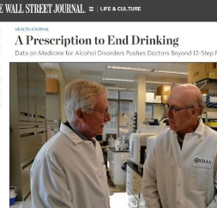
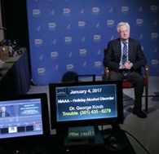
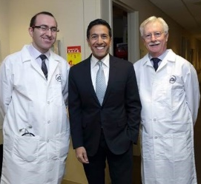
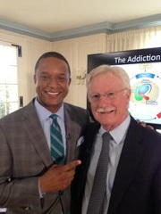
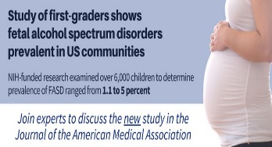
Outreach and Marketing: Enhancing Visibility
NIAAA efforts
Robust program including social media (Twitter, Instagram), extensive news outreach, outreach partnerships, stakeholder communications, website redesign, and increasing use of video and innovative multimedia technologies
How can you help?
Mention your NIAAA funding in media interviews, retweet our social media posts, share NIAAA products with colleagues and news media or blogging contacts
Become part of a new project to publicize notable NIAAA-funded discoveries:
Tell us about your notable NIAAA-funded papers as soon as they have been accepted for publication - and about new resources like mobile apps and educational resources for schools and communities.
We can publicize your work through press releases, research news write-ups on our website, and social media posts.
Contact us at: NIAAAresearchnews@mail.nih.gov

Slide 14
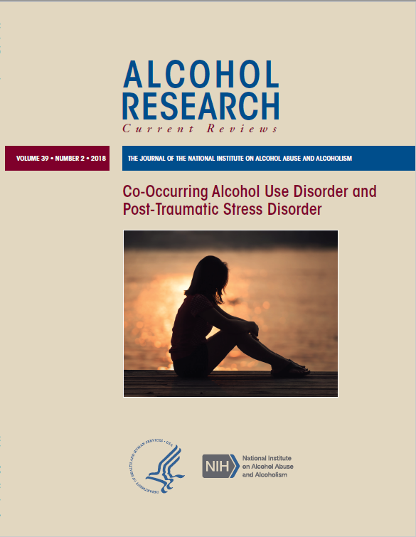
NIAAA Publishes an Open-Access Peer-Reviewed Journal
Alcohol Research: Current Reviews
Published twice a year
Each themed issue includes a series of invited review articles that cover the topic from a variety of research disciplines
https://www.arcr.niaaa.nih.gov/
Current Issue:
Co-Occurring Alcohol Use Disorder and PTSD
Upcoming Issues:
Alcohol Use Disorder and Co-Occurring Mental Health Conditions
Women and Alcohol
Editor-in-Chief:
Troy Zarcone, Ph.D.
2018 Impact Factor: 7.174
Learn more at the NIAAA exhibit booth!

Slide 15
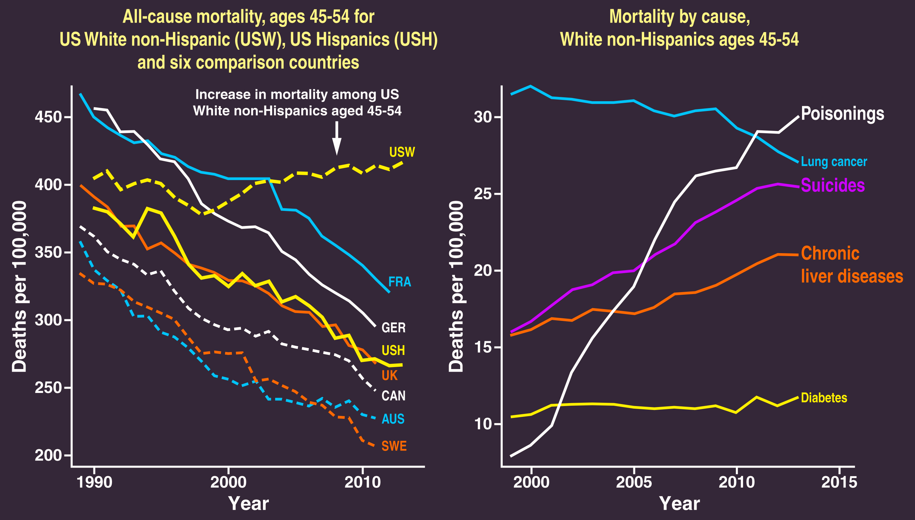
“Deaths of Despair”
Source: Case, A and Deaton, A (2015) Rising morbidity and mortality in midlife among
white non-Hispanic Americans in the 21st century. PNAS 112: 15078-15083.
Notes:
053118 Koob NIAAA slide01c

Slide 16
Relative Scope of the Problem:
Opioids versus Alcohol
Opioids
Misuse* | 11,401,000
% of population | 4.2
OUD | 2,110,000
% of population | 0.8
ED visits | 408,079 Primary reason
 | 1,461,770 All opioid-related
Deaths | 47,600 Total overdoses
 | 17,029 Prescription opioids
 | 28,400 Fentanyl and similar
 | 15,482 Heroin
Alcohol
Use | 178,736,000
% of population | 65.7
AUD | 14,500,000
% of population | 5.3
ED visits | 1,714,757 Primary reason
 | 4,936,690 All alcohol-related
Deaths | ~88,000 Total deaths
 | 49,544 Acute – overdose, injury
 | 38,880 Chronic – liver, cancer
*Any past year heroin use or prescription opioid use other than as prescribed
Sources: NSDUH, 2017 people aged 12+; Nationwide Emergency Department Sample, 2016; CDC Overdose Death Data, 2017; CDC Alcohol Related Death Inventory, 2006-2010; White et al, 2018
Opioid + alcohol overdose deaths
7,270 (15% of all opioid overdose deaths involved alcohol in 2017)
Courtesy of Dr. Aaron White, NIAAA

Slide 17
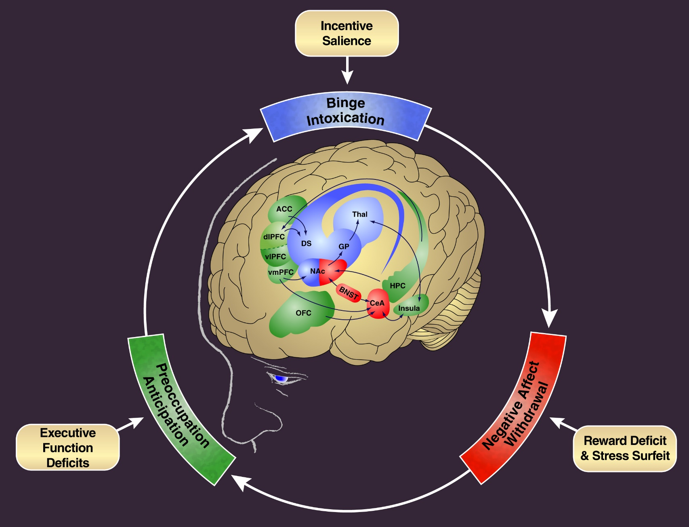
Conceptual Framework: Neurobiological Bases Driving Substance Use Disorders
Notes:
112116 Koob NIAAA slide2

Slide 18
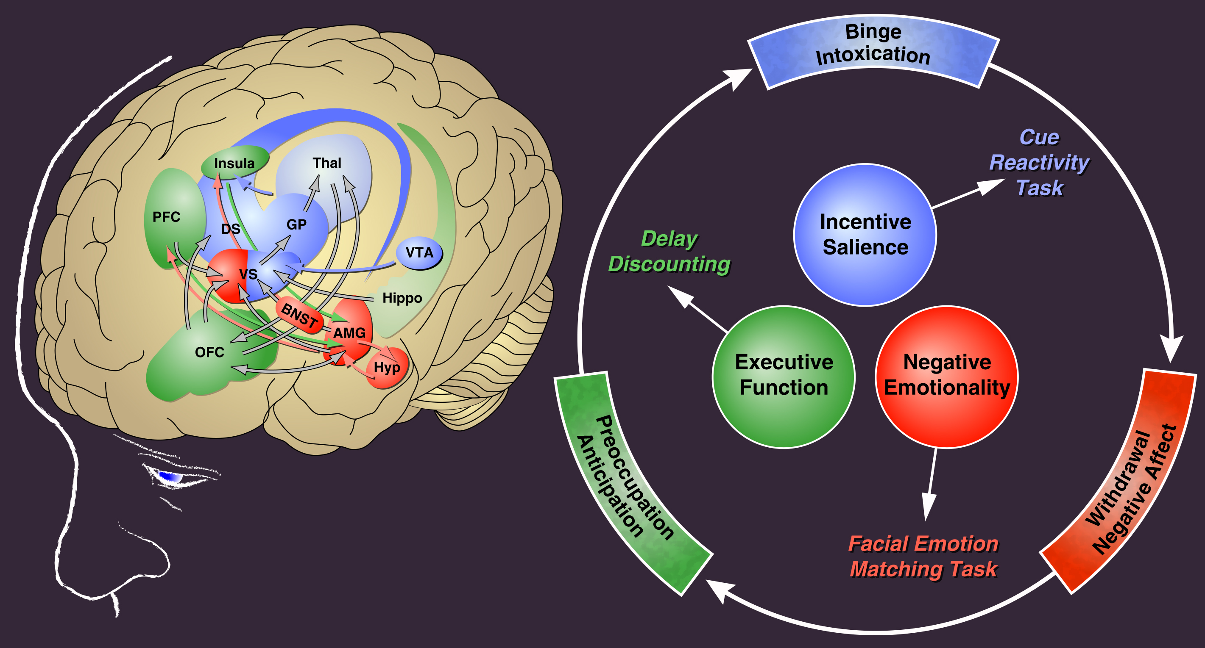
Addictions Neuroclinical Assessment:
Associations with Neurocircuits Provides a Framework for improved Diagnosis, Prevention and Treatment
Adapted from Koob. Curr Top Behav Neurosci. 2011
Modified from: Kwako LE, Momenan R, Litten RZ, Koob GF, Goldman D. Addictions neuroclinical assessment:
a neuroscience-based framework for addictive disorders. Biological Psychiatry, 2016, 80:179-189
Notes:
050319 Koob NIAAA Lab review slide22

Slide 19
Update: Validation of Three Neurofunctional Domains in AUD by Deep Behavioral Phenotyping
This study examined three key neurobiological domains that are critical to the addiction cycle (incentive salience, negative emotionality, and executive function) in a large, diverse clinical sample of individuals representing the spectrum of AUD.
Measures of addiction, personality, cognition, behavior, and exposure to early-life stress were collected. Using a multiple indicators, multiple causes approach, the study confirmed the relevance of the three neurofunctional domains to AUD.
PREDICTORS
LATENT FACTORS
INDICATORS
AUD diagnosis
Gender
Emotional abuse
Sexual abuse
Emotional neglect
Positive urgency
Neuroticism
Extraversion
Agreeableness
Trait anxiety
Aggression
Negative Emotionality
ADHD
Attentional impulsivity
Motor impulsivity
Non-planning impulsivity
Conscientiousness
Negative urgency
Premeditation
Perseverance
Positive urgency
AUD diagnosis
Race
Emotional abuse
Sexual abuse
Family history
Age at first drink
Executive Function
MADRS depression
Trait anxiety
Distress when unable to drink
Preoccupation with alcohol
Time thinking about alcohol
Strength of urge to drink
AUD diagnosis
Race
Emotional abuse
Emotional neglect
Incentive Salience
From: Kwako LE, Schwandt ML, Ramchandani VA, Diazgranados N, Koob GF, Volkow ND, Blanco C, and Goldman D. Neurofunctional domains derived from deep behavioral phenotyping in alcohol use disorder. Am J Psychiatry. 2019

Slide 20
Update: Longitudinal Brain Development Studies
National Consortium on Alcohol and Neurodevelopment in Adolescence
(N-CANDA)
Adolescent Brain Cognitive Development (ABCD) Study
Ongoing multisite longitudinal study of youth (ages 12-21) to elucidate the effects of alcohol exposure on the developing brain
Recent results include evidence that youth who initiate heavy drinking have accelerated declines in gray matter volume and slower expansion of white matter at later time points
N-CANDA laid the methodological foundation for the ABCD study
Ongoing multisite study tracking the biological, cognitive, and behavioral development of youth (ages 9-10) over a 10 year period
Enrollment is now complete! (N=11,875)
Baseline curated data released in April 2019, available through the NIMH Data Archive
https://data-archive.nimh.nih.gov/abcd
MRI of adolescent brains activated during a memory task in ABCD study.
Photo credit: Dr. Richard Watts and Dr. Hugh Garavan

Slide 21
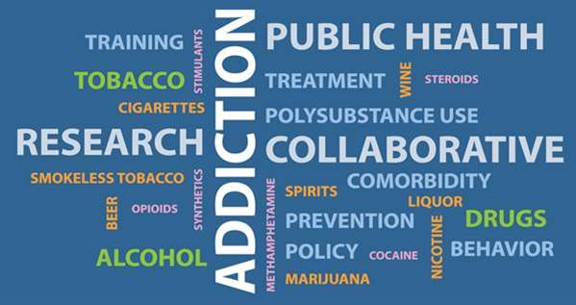
Update: Functional Integration with NIDA
Collaborative Research on Addiction at NIH (CRAN)
Includes NIAAA, NIDA, and NCI Division of Cancer Control and Population Sciences
Joint Advisory Council meetings held each May
ABCD Study
Other examples
Co-sponsorship of multiple funding opportunity announcements
NIDA-NIAAA Neuroscience Working Group that organizes the annual Frontiers in Addiction Research Mini-Convention
NIDA-NIAAA Scientific Review Committee includes staff from both institutes that review the scientific and technical merit of human subjects research protocols submitted by investigators in the Intramural Research Program of each institute

Slide 22
Update: Brain Research through Advancing Innovative Neurotechnologies® (BRAIN) Initiative
A focus on circuits and networks
“The challenge is to map the circuits of the brain, measure the fluctuating patterns of electrical and chemical activity flowing within those circuits, and understand how their interplay creates our unique cognitive and behavioral capabilities.”
25 active FOAs in the following areas:
Cell Diversity/Tools for Cells and Circuits (5)
Neural Recording, Modulation, and Stimulation (7)
Understanding Neural Circuits (6)
Data Science/Data Infrastructure (3)
Training and Dissemination (2)
Neuroethics (1)
Small Business (1)
https://braininitiative.nih.gov/
Array Tomography of Mouse Cortex- S. Smith Laboratory Stanford University

Slide 23
Update: Diagnosis and Treatment of Fetal Alcohol Spectrum Disorders
FASD prevalence: as high as 1.1 – 5% among four U.S. communities (May et al., 2018)
Current research to improve screening, diagnosis, prevention, and treatment of FASD:
Refining 3D facial imaging to improve diagnosis
Adapting a neurobehavioral screening tool (Decision Tree) for mobile use
Developing culturally-appropriate approaches for the prevention of alcohol-exposed pregnancies
Exploring maternal immune profiles as biomarkers of prenatal alcohol exposure and risk of neurodevelopmental delay
Testing choline supplementation to mitigate adverse effects of prenatal alcohol exposure
NIAAA is convening a consensus conference to attempt to harmonize classification systems for research on FASD

Slide 24
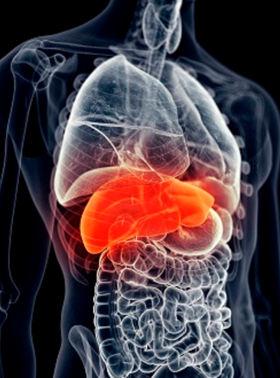
Update: Advancing Research on Alcohol-Associated Liver Disease
~ 50% of U.S. liver disease deaths are attributable to alcohol misuse
Alcohol-associated liver disease (AALD) now replaces hepatitis C virus as the leading cause of liver transplantation due to chronic liver disease
Alcoholic Hepatitis Network: NIAAA established a clinical and translational network to streamline the design, initiation, and conduct of clinical trials for alcoholic hepatitis, reduce administrative redundancy, and optimize the use of scientific innovations
In development: NIAAA Core Liver Resource that provides fundamental information about AALD for health care providers

Slide 25
Priority: Advancing Treatment for AUD
Evidence-based behavioral treatments such as:
Cognitive behavioral therapy (CBT)
Motivational interviewing
Three FDA-approved medications for treatment of AUD:
Disulfiram (Antabuse)
Naltrexone (Vivitrol, ReVia)
Acamprosate (Campral)
…BUT fewer than 10% of people with AUD receive any form of treatment!
NIAAA Goals:
Development and refinement of behavioral treatments
Identify novel targets and support medications development
Explore alternative clinical trial endpoints
Support research to define recovery
Health services: Integrate prevention, early intervention, and treatment into routine health care

Slide 26
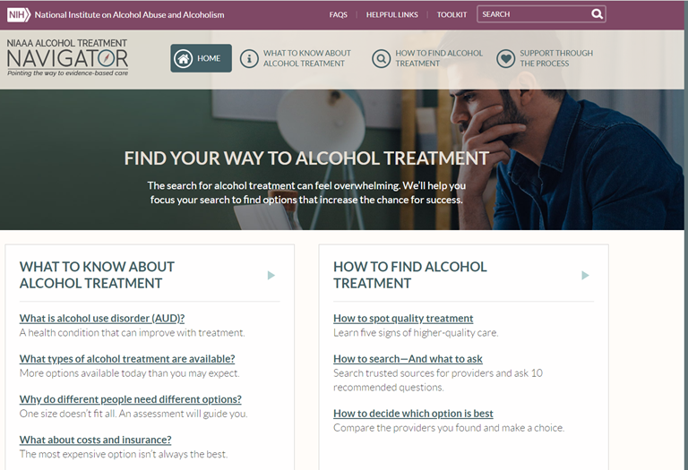
Priority: Disseminating Information about Alcohol and Alcohol Treatment Services
The Alcohol Treatment Navigator was designed to help people understand treatment options and locate providers:
https://alcoholtreatment.niaaa.nih.gov/
NIAAA is currently developing resources to support integration of prevention, early intervention, and treatment into routine health care:
Clinician’s Navigator – a resource to help health professionals guide their patients to treatment
Clinician’s Core Resource – what every clinician needs to know about alcohol
NIAAA continues to encourage research in health services and dissemination/implementation science with respect to alcohol treatment.

Slide 27
Emerging Issue: NIAAA Supports Clinical Informatics Approaches & Big Data Capacity
Future opportunities for secondary data analysis
and application of big data analytic techniques, like AI, are coming:
The NIH All of Us Research Program will collect “big data” (including alcohol-related measures) on 1 million people
Data sources will include electronic health records, patient-reported responses on smartphone, genomics, and in-clinic visits
The NIAAA Data Archive will serve as a repository for human subjects data from most NIAAA-funded grants (effective Jan. 25, 2019; NOT-AA-18-010)
For more info, visit the NIMH Data Archive RSA exhibit booth (Sun-Wed)
NIAAA Point of Contact: Dr. Daniel Falk (falkde@mail.nih.gov)
NIAAA supports training in new analytic techniques
Participation in a recent NIH-wide FOA (RFA-OD-19-011), using the T32 training mechanism
Funding supports training the next generation of scientists to apply sophisticated analytic approaches, such as artificial intelligence, to “big data” sources, including electronic health records

Slide 28
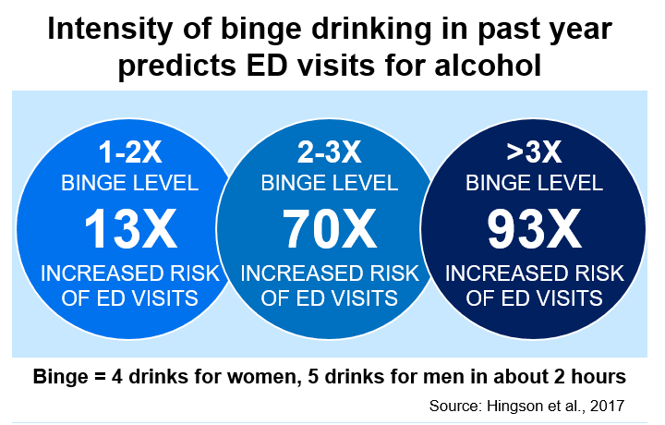
Emerging Issue: High-Intensity Drinking
High-Intensity Drinking: alcohol intake at levels twice or more the threshold for binge drinking (predictive of increased harm)
In October 2018, NIAAA convened a working group consisting of experts in alcohol and drug policy, neuroscience, digital media, social media analysis, adolescent alcohol intervention research, and global health
The discussion focused on biological determinants (e.g., tolerance) and sociocultural factors (e.g., societal norms) that influence this behavior
A meeting summary is available on the NIAAA website.

Slide 29
Emerging Issue: Alcohol and Women’s Health
Gaps between women and men are narrowing for prevalence, early onset drinking, frequency and intensity of drinking, having AUD, drunk driving, and self-reported consequences (Grucza et al., 2018; Slade et al., 2016; White et al, 2015)
Women more likely to experience blackouts, liver inflammation, brain atrophy, cognitive deficits, certain cancers, negative affect during withdrawal and stress, and anxiety-induced relapse (Becker and Koob, 2016)
Only 26% of 230 structural neuroimaging studies on substance use over 23 years evaluated sex differences (Lind et al., 2017)

Slide 30
Emerging Issue: Rising Alcohol Use Among Older Adults (Aged 65+)
This population is more sensitive and vulnerable to effects of alcohol due to age-related:
reductions in body water content
declines in alcohol metabolism pathways
“inflamm-aging” (a low-grade, chronic inflammatory state)
neurobiological differences
Questions of interest include:
How is the immune system primed by alcohol to accelerate aging?
How does alcohol modulate neuroinflammation or neuroimmune interactions associated with dementia?
What genetic/epigenetic factors confer vulnerability to alcohol-aging interactions?
Percent
AAPC = average annual percentage change; ^p<0.025; †among current drinkers.
Source: Breslow et al., 2017
RSA symposium 2019: “Alcohol Use as We Age”, Great Lakes C, Monday 3:10 PM to 4:40 PM
Notes:
113017 Koob NIAAA slide01
Alcohol cost changed to $249B to reflect CDC paper published in 2015 that estimated costs for 2010.
Per NSDUH (SAMHSA survey): AUD prevalence in 2014 was 16.3M for age 18 and older, and 17.0 for age 12 and older.
NCI: The number of people living beyond a cancer diagnosis reached nearly 14.5 million in 2014 and is expected to rise to almost 19 million by 2024.
NCI: National expenditures for cancer care in the United States totaled nearly $125 billion in 2010 and could reach $156 billion in 2020.

Slide 31
Emerging Issue: Alcohol and Pain
Overdose
Binge/Intoxication
Adapted from Dr. Mark Egli, NIAAA
16-25% chronic pain patients drink heavily or have AUD
Alcohol
Use
Opioid
Use
K Witkiewitz & KE Vowles (2018) Alcohol Clin Exp Res
43%-73% of individuals with AUD have moderate to severe pain
Preoccupation/Anticipation
“Craving”
K Witkiewitz & KE Vowles (2018) Alcohol Clin Exp Res
Impulsivity (Negative Urgency)
Acute alcohol (at binge levels) is analgesic (relieves pain)
Withdrawal/
Negative Affect
T Thompson et al. (2017) Journal of Pain
Sensory & Emotional Pain
Chronic alcohol and withdrawal produce hyperalgesia (increased pain sensitivity)
S Edwards et al. (2012) Neuropharmacology
Suicide
RSA Symposium 2019: “Digging in to Pain-Alcohol Interactions as a Driver of Abuse”, Tuesday 9:15 AM to 10:45 AM, Greenway BC-HI

Slide 32
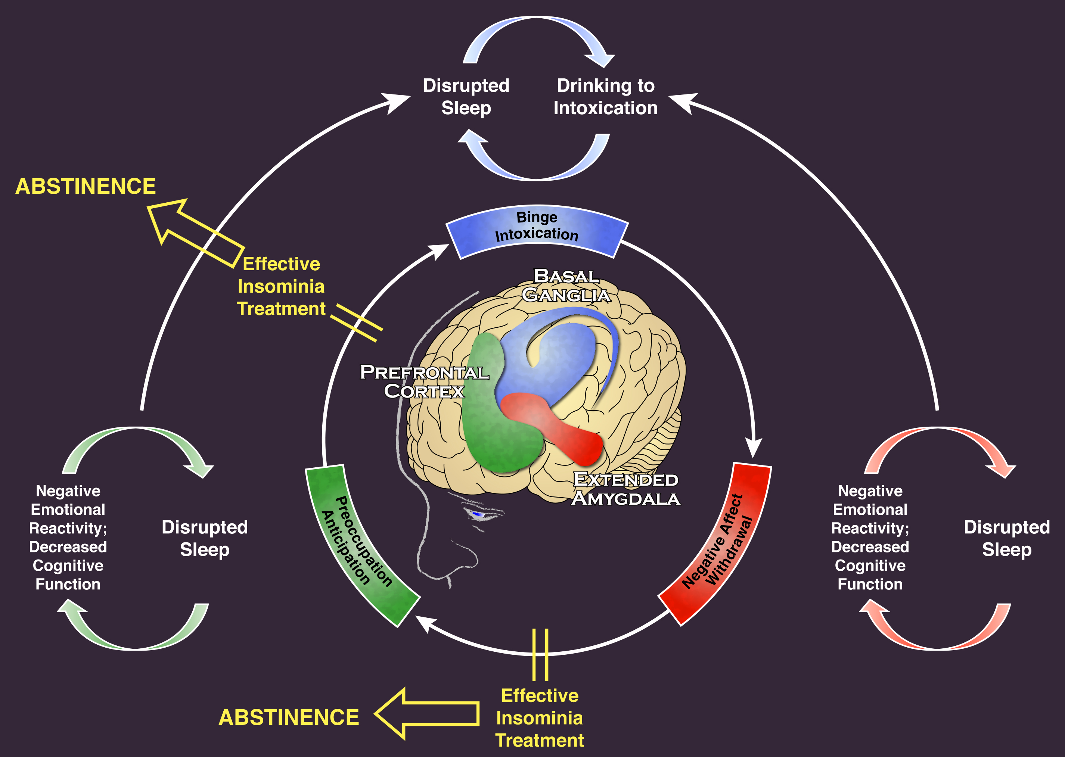
Emerging Issue: Alcohol Use Disorder and Sleep Disturbance – A Feed Forward Allostatic Framework
RSA Symposium 2019: “It’s about Time: Circadian Rhythms and Alcohol-Induced Effects” Wednesday, 9:15- 1-:45 AM, Greenway BC-HI
Koob and Colrain, Neuropsychopharmacology Reviews, in press
Notes:
040819 Koob NIAAA fig4c

Slide 33
Thank You!
Special thanks to:
Rachel Anderson
Judy Arroyo
Abe Bautista
Changhai Cui
Fred Donodeo
Bill Dunty
Dan Falk
Kathy Jung
Raye Litten
Lynn Morin
Elizabeth Powell
Patricia Powell
Aaron White
Bridget Williams-Simmons
@NIAAAnews

Slide 34
Question: What steps are being taken to increase federal funds to NIAAA in proportion to alcohol's role in the US?
Congress determines NIAAA’s appropriation annually.

Slide 35
Question: What is the most important advice for rodent researchers to stay relevant across the next 10 years?
Educate yourselves about clinical phenotypes and consider back-translating.
Follow developments in the BRAIN initiative.
Follow other fields that may be related to your research domain. These may include fields such as immunology and cancer research.

Slide 36
Question: Would NIAAA consider regularly collecting applicant and grantee ratings, comments, and suggestions about their interactions with NIAAA?
NIAAA is currently exploring new ways for grantees to provide feedback.
As always, grantees may reach out to their PO or the respective Division Director or Office Director with concerns:
Division of Epidemiology and Prevention Research
Dr. Ralph Hingson, Director
Dr. Mike Hilton, Deputy Director
Division of Metabolism and Health Effects
Dr. Kathy Jung, Director
Dr. Svetlana Radaeva, Deputy Director
Division of Neuroscience and Behavior
Dr. Antonio Noronha, Director
Dr. Mark Egli, Deputy Director
Division of Medications Development
Dr. Raye Litten (Acting Director)
Division of Treatment and Recovery Research
Dr. Raye Litten (Acting Director)
Office of Extramural Activities (Extramural Peer Review and Grants Management)
Dr. Abraham Bautista, Director

